Slide 1
Programming Massively Parallel Architectures in OpenCL
Presented By Greg Somers for CEG4136
Nov 4, 2016
Notes:
Explain reasons why GPU/FPGA other massively parallel architectures are important
Inclusion in super computer
Inclusion in amazon cloud offerings
Any data parallel tasks – many linear algebra operations can be performed, to some, degree, in parallel

Slide 2
Agenda
Introduction & Motivation
Introduction to OpenCL
Introduction to Massively Parallel Architectures / General Purpose GPU
OpenCL By Example
Closing Remarks

Slide 3
About Me
Staff Software Engineer, IBM Watson Analytics
M.A.Sc Electrical & Computer Engineering – University of Ottawa 2016
Thesis topic: Acceleration of Block-Aware Matrix Factorization on Heterogeneous Platforms
B.A.Sc Computer Engineering – University of Ottawa 2013

Slide 4

Motivation - Matrix Multiplication
$$A ∗B=C$$
Notes:
Let’s start by exploring the multiplication of two square matrices. We can see that that the computation of each entry, say (1,1) or (1,2), in the resulting matrix is independent of each other.
The operation is Θ(n³), where n is the dimension of the matrix

Slide 5
Motivation - Matrix Multiplication
Sequential Square Matrix Multiplication (in pseudo C):
Notice that the same multiply add operation is being performed on all of the data
Notes:
The sequential case to be executed on a single core of a CPU looks as follows
The innermost loop is independent and can be computed on different threads
Imagine we break this up into a 2 dimensional space as follows

Slide 6
Motivation - Matrix Multiplication
Imagine the computation of C(1,1) by calling a function computeCell passing in the first row of A and the first column of B

Slide 7
Motivation - Matrix Multiplication
We can then compute all of the entries of the matrix C in parallel by calling computeCell from many threads
C(1,1) = computeCell(A[Col 1], B[Row 1], 3);
C(1,2) = computeCell(A[Col 1], B[Row 2], 3);
C(1,3) = computeCell(A[Col 1], B[Row 3], 3);
…
C(2,1) = computeCell(A[Col 2], B[Row 1], 3);
…
C(3,3) = computeCell(A[Col 3], B[Row 3], 3);
Notes:
This function can be viewed from the outside as an atomic operation or instruction, it is generic and can apply to the computation of any given entry in the C matrix.

Slide 8
Motivation
Recall the definition of SIMD from Flynn’s taxonomy
Single instruction multiple data – computeCell function behaves the same, only the data needs to change
Assume the matrices A and B are 32x32, we could use 1024 cores to compute the multiplication fully in parallel
C(1,1)
C(1,2)
C(1,3)
C(1,4)
C(1,5)
C(1,6)
C(1,7)
C(1,8)
C(1,9)
C(1,10)
C(32,32)
…
CPU
Core1
Core2
Core3
Core4
Core5
Core6
Core7
Core8
Core9
Core10
…
Core1024
Notes:
How can we do this efficiently with the support of some programming language?
Exploits the data level parallelism

Slide 9
Agenda
Introduction & Motivation
Introduction to OpenCL
Introduction to Massively Parallel Architectures / General Purpose GPU
OpenCL By Example
Closing Remarks

Slide 10
Introduction to OpenCL
OpenCL (Open Computing Language) - is a standard for writing portable parallel applications which run across a multitude of heterogeneous platforms (FPGA, CPU, GPU, APU).
Applications don’t need to be re-written to target different architectures or hardware vendors
An OpenCL system consists of a host and one or more accelerators, which run compute “kernels” written in a subset of the C99 standard
Underlying hardware is abstracted away by a platform model, execution model, memory model, and a programming model
Host
FPGA Device 1
GPU Device 1
…
GPU Device N
…
Notes:
OpenCL (Open Computing Language) is a standard for writing portable parallel applications which
run across a multitude of heterogeneous platforms. Applications written using the OpenCL API (Application
Programming Interface) can target accelerator devices such as Accelerated Processing Units
(APUs), multi-core CPUs, GPUs, and Field-Programmable Gate Arrays (FPGA) without modication
or maintaining multiple versions of the application. An OpenCL system consists of a host and one or
more accelerators, which run kernels written in a subset of the C99 standard dened by [15]. OpenCL operations
are exposed to host applications via a standardized API while the underlying host-to-hardware
interaction is implemented by the device vendor. The OpenCL standard is best described by four models:
the platform model, the execution model, the memory model, and the programming model. The four
models as well as methods for performing synchronization are discussed in the following subsections.

Slide 11
Introduction to OpenCL
OpenCL provides a C/C++ API to interact with
Basic Constructs
Devices – A collection of devices which support OpenCL
Command Queues – used to schedule commands for execution on the device
Kernels – The code to be executed on the OpenCL devices
Memory Buffers – Linear blocks of memory allocated in host and device memory
Common Setup Steps
Query for platforms (e.x. AMD, Intel, NVidia)
Query for devices (e.x. GPU, CPU)
Create a context
Create a Command queue
Issue commands to the device

Slide 12
OpenCL Issuing Commands
Each device can have one or more command queues
Operations submitted to the queue with execute on the device in order (out of order execution has limited support)
Example list of operations submitted to a command queue
Allocate Buffer in device memory
Copy input data from host to device
Launch kernel
Copy output data back to host

Slide 13
OpenCL Execution Model – Device Side
A kernel executed on a device is comprised of many work-items
The work-item is the smallest unit of work, which can be thought of as a single instance of a kernel
Each work item has a unique id within a 1,2,or 3 dimensional index space known as the NDRange
A work-group is a grouping of multiple work-items which execute concurrently
In the matrix multiplication example, we could choose a work group size of 16x16, which means 4 work groups are required to compute all 1024 values
C(1,1)
C(1,2)
C(1,3)
C(1,4)
C(32,32)
…
GPU
Core1
Core2
Core3
Core4
…
Core1024
Work item
computeCell Kernel
Notes:
The execution model is divided into two parts, the host bound execution which invokes the OpenCL
API, and the kernel execution which is performed on the accelerator. On the device side, the smallest
unit of work is referred to as a work-item, which represents a single instance of a kernel. A work-item is
indexed in a space referred to as the NDRange. The NDRange can be one, two, or three dimensional,
and for each point in the NDRange there exists a kernel instance (work-item). A work-group is dened
as a grouping of multiple work-items which execute concurrently on a single compute unit.

Slide 14
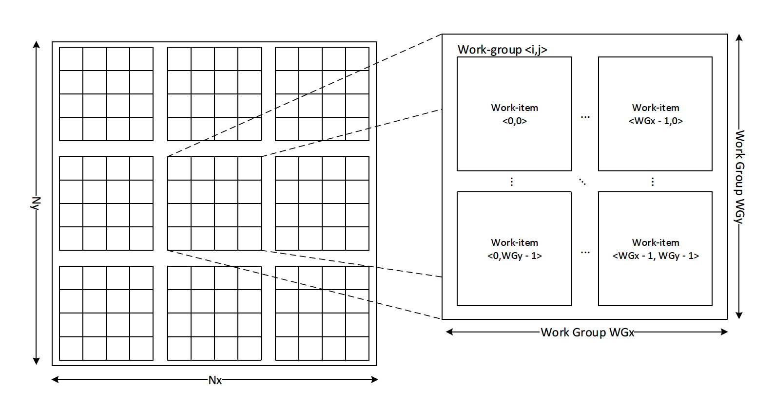
OpenCL Execution Model
Notes:
2-dimensional NDRange, where the range is composed of Nx x Ny work-items. The
work-items are segregated into work-groups of size WGxWGy where each work-item is given a unique
identier within the work-group. Work-items are also indexed globally, which identies them based on
their index in the NDRange space. The total number of work-groups in the space is given by
parameters WGx , WGy , Nx and Ny are defined by the application and the problem to be solved.

Slide 15
OpenCL Execution Model – Host Side
On the host, an OpenCL context is used to group
Devices
Kernels
Memory Objects
Command Queues
Resources cannot be shared between contexts
Notes:
On the host side, the OpenCL execution model uses contexts to group resources containing one or more
of the following: devices, kernels, memory objects, and command queues. These resources cannot be
shared between contexts, but only between devices in the same context. Devices belonging to the same
platform can be contained in a single context or each belong to their own context. Command queues are
assigned to devices within the context and facilitates issuing of memory and kernel execution commands
to that device.

Slide 16
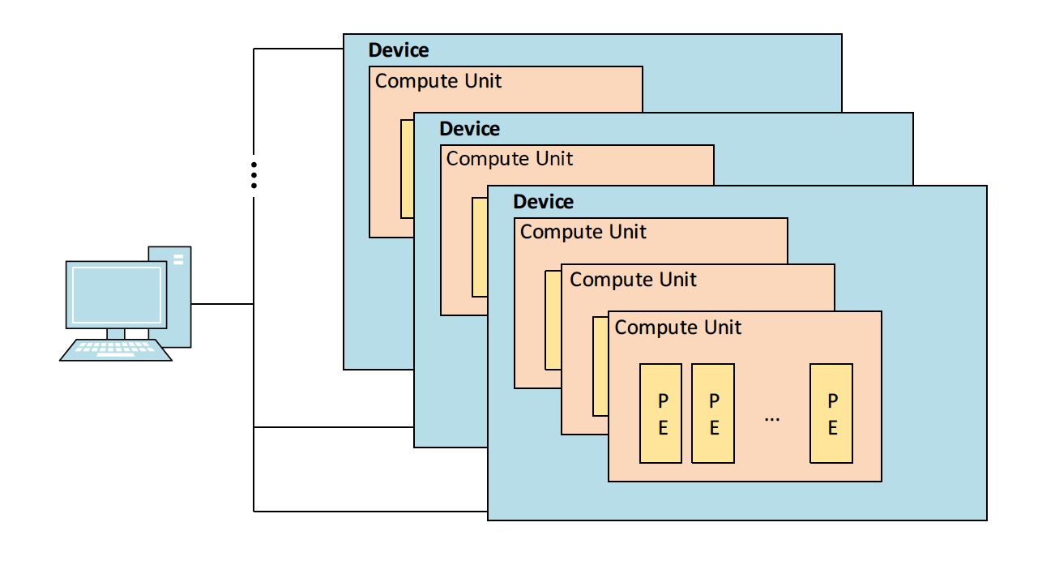
OpenCL Platform Model
Defines the relationship between the host and the attached accelerators (such as GPUs)
Abstracted view of the underlying hardware logically divided into one or more Compute Units, which are further split into Processing Elements
The hardware vendor (e.x. AMD, Nvidia, Altera) provides an OpenCL implementations which maps this OpenCL abstraction onto their specific underlying hardware
Notes:
The OpenCL platform model defined the relationship between the host and the attached accelerators
(Such as GPUs) which support OpenCL. OpenCL uses an abstracted view of the underlying hardware
that is logically divided into one or more Compute Units, which are further split into Processing Elements
(Figure 2.4).
The hardware vendor's OpenCL implementation maps this OpenCL abstraction onto their specic underlying
hardware which can vary drastically between devices such as GPUs, CPUs and FGPAs. In a
single host system there can be multiple platforms present depending on the installed implementations,
with each platform supporting one or more devices. For example, a host with two GPUs, each from
dierent vendors, and an FPGA, could have three platforms implemented by each of the GPU vendors
as well as the FPGA vendor.

Slide 17
OpenCL Programming Model
Work groups are distributed across the many compute units (CU) on the device.
A workgroup remains locked to a single CU throughout its execution
Processing elements (PEs) perform the work-item computations
Synchronization is only possible between work items in the same workgroup
Notes:
The OpenCL platform model defined the relationship between the host and the attached accelerators
(Such as GPUs) which support OpenCL. OpenCL uses an abstracted view of the underlying hardware
that is logically divided into one or more Compute Units, which are further split into Processing Elements
(Figure 2.4).
The hardware vendor's OpenCL implementation maps this OpenCL abstraction onto their specic underlying
hardware which can vary drastically between devices such as GPUs, CPUs and FGPAs. In a
single host system there can be multiple platforms present depending on the installed implementations,
with each platform supporting one or more devices. For example, a host with two GPUs, each from
dierent vendors, and an FPGA, could have three platforms implemented by each of the GPU vendors
as well as the FPGA vendor.

Slide 18
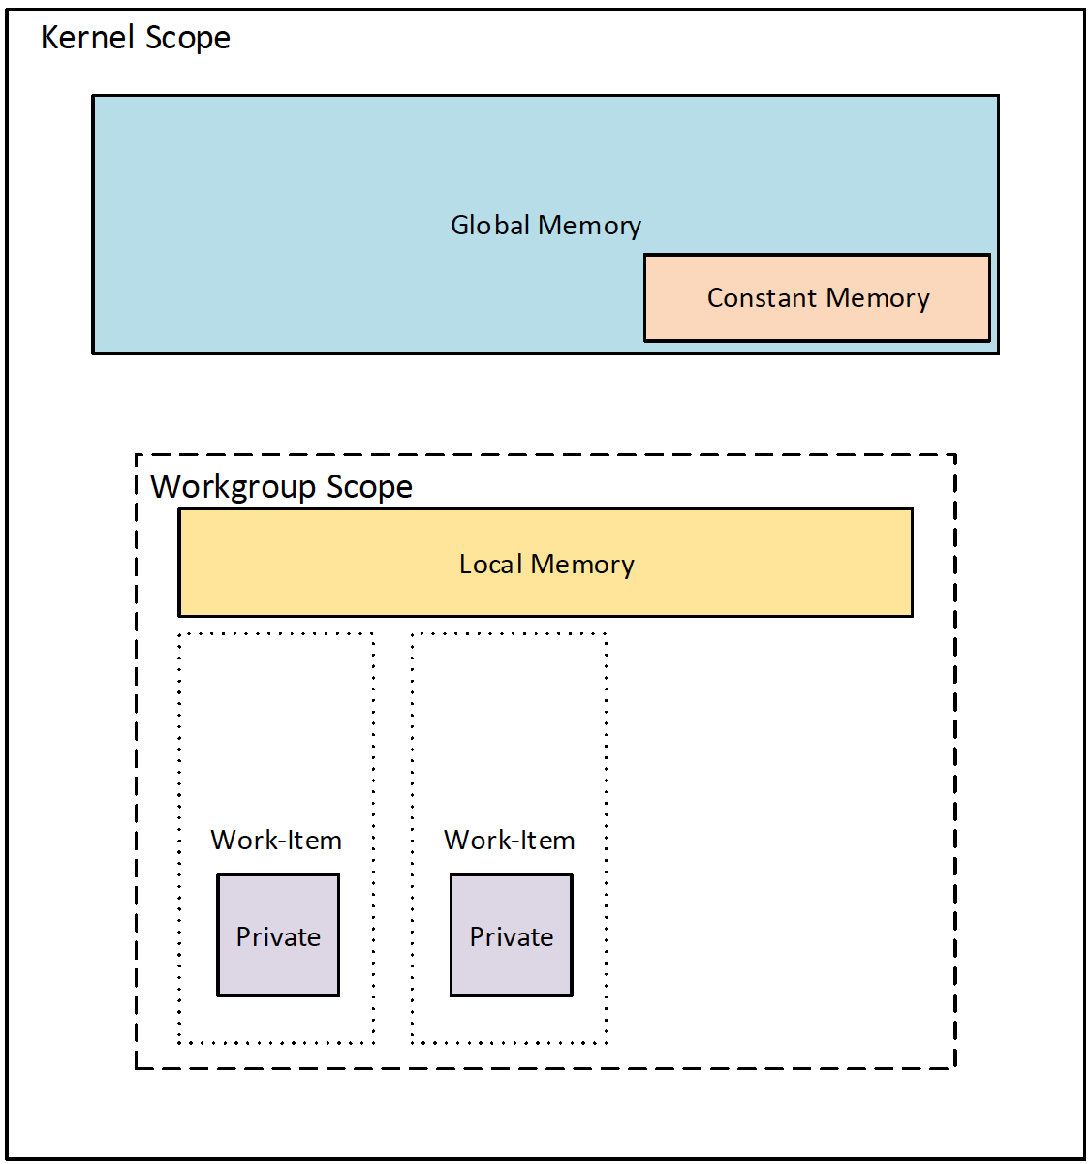
OpenCL Memory Model
Abstract hierarchy which OpenCL kernels use without requiring any knowledge of the underlying hardware organization. Split up into 4 sections:
Global – all work items have read/write access
Local – read/write access shared between all work-items within the same workgroup
Private - only accessible by the work-item to which it is assigned
Constant: work-item have no write access
Notes:
OpenCL has relaxed assumptions about the consistency of memory, thus the state of memory is not
guaranteed to be consistent in all situations [15]. Local and global memory is guaranteed to be consistent
for work-items in a single work-group only after a work-group barrier is encountered by all work-items.
There are no guarantees of consistency between work-groups. Additionally, since memory is not shared
between contexts, using multiple contexts requires the explicit transfer of data between devices belonging
to dierent contexts. Finally, memory objects in OpenCL are referred to as buers and can be allocated
in host and device memory.

Slide 19
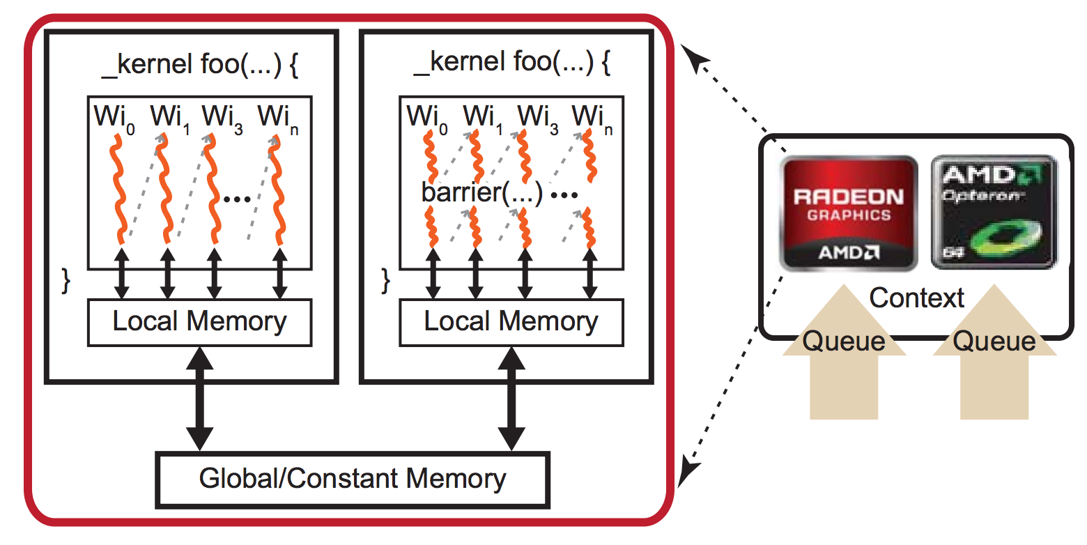
OpenCL Memory Synchronization
The state of memory is not guaranteed to be consistent in all situations!
Local and global memory is guaranteed to be consistent for work-items in a single work-group only after a work-group barrier is encountered by all work-items
There are no guarantees of global memory consistency between work-groups
Notes:
OpenCL has relaxed assumptions about the consistency of memory, thus the state of memory is not
guaranteed to be consistent in all situations [15]. Local and global memory is guaranteed to be consistent
for work-items in a single work-group only after a work-group barrier is encountered by all work-items.
There are no guarantees of consistency between work-groups. Additionally, since memory is not shared
between contexts, using multiple contexts requires the explicit transfer of data between devices belonging
to dierent contexts. Finally, memory objects in OpenCL are referred to as buers and can be allocated
in host and device memory.

Slide 20
Agenda
Introduction & Motivation
Introduction to OpenCL
Introduction to Massively Parallel Architectures / General Purpose GPU
OpenCL By Example
Closing Remarks

Slide 21
General Purpose AMD GCN GPU Architecture
Graphics Core Next arrived in 2011 and is AMD’s first architecture aimed at general purpose computing
Uses a RISC instruction set
The Compute Unit (CU) is at the heart of GCN’s design
For the Southern Islands family of device each CU includes 4 SIMD units for vector processing
A wavefront is a hardware thread with its own program counter; capable of following control flow independently of other wavefronts.
AMD Radeon™ HD 79XX series GPUs have 64 work-item wavefronts

Slide 22
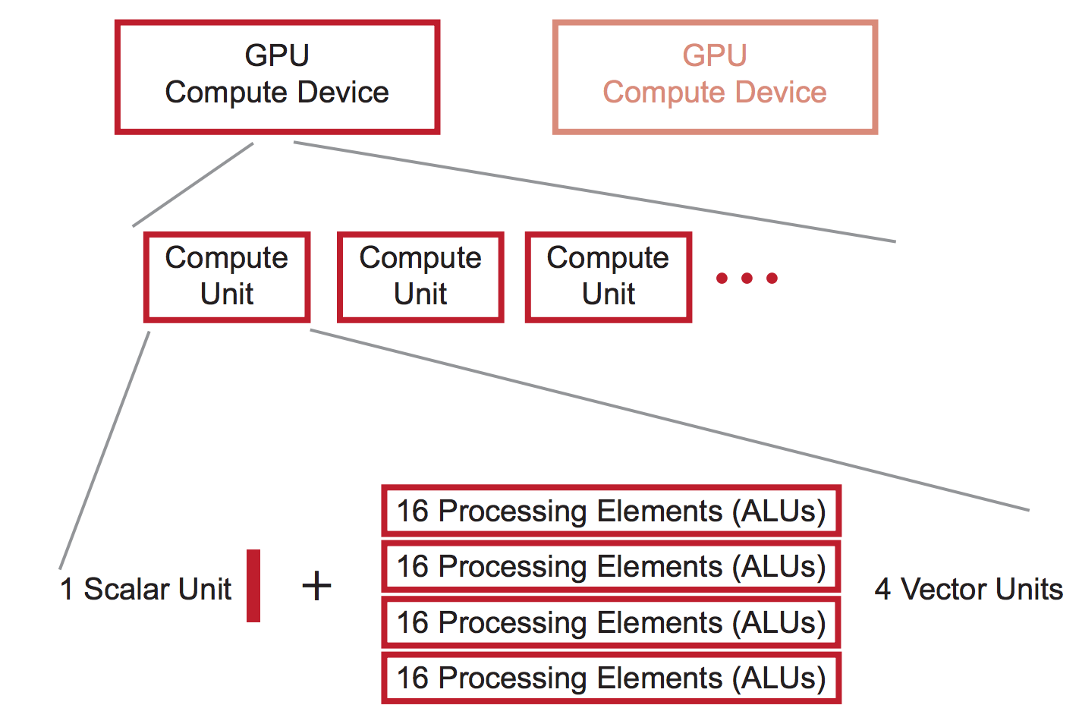
Simplified GCN GPU Architecture
Notes:
Scalar unit is used for control flow; for example, comparisons will generate a result for each of the 64 work-items in a wavefront.

Slide 23
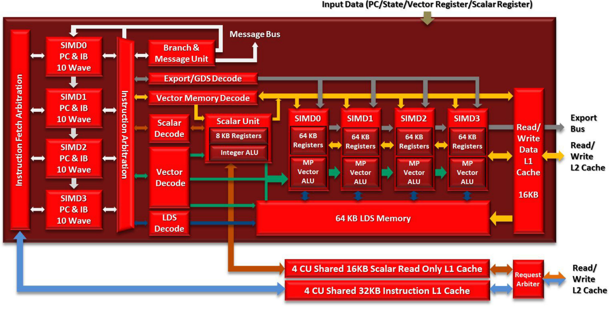
Notes:
The cache coherency protocol shares data through the L2 cache,
4 Compute Units share a single 32KB L1 instruction cache that is 4-way associative and backed by the L2 cache.
The compute unit selects a single SIMD to decode and issue each cycle, using round-robin arbitration.
branches, scalar ALU or memory, vector ALU, vector memory, local data share, global data share or export
Each compute unit has an 8KB scalar register file that is divided into 512 entries for each SIMD.
The scalar L1 data cache is a read only structure. Since the scalar pipelines are primarily meant for control flow, there is no need to write results back to memory.
The 16KB scalar data L1 is 4-way associative with 64B lines and LRU replacement
The vector register file the register file can be partitioned into four independent slices, SIMD has a 64KB partition of vGPRs
Each SIMD includes a 16-lane vector pipeline

Slide 24
AMD GCN GPU Architecture
Each SIMD unit can handle 10 wavefronts. The entire CU can have 40 wavefront simultaneously
A wavefront is issued to a SIMD in a single cycle, but takes 4 cycles to execute operations for all 64 work items.
The Radeon™ HD 7970 has 32 CUs and can process up to 81,920 work items at a time.

Slide 25
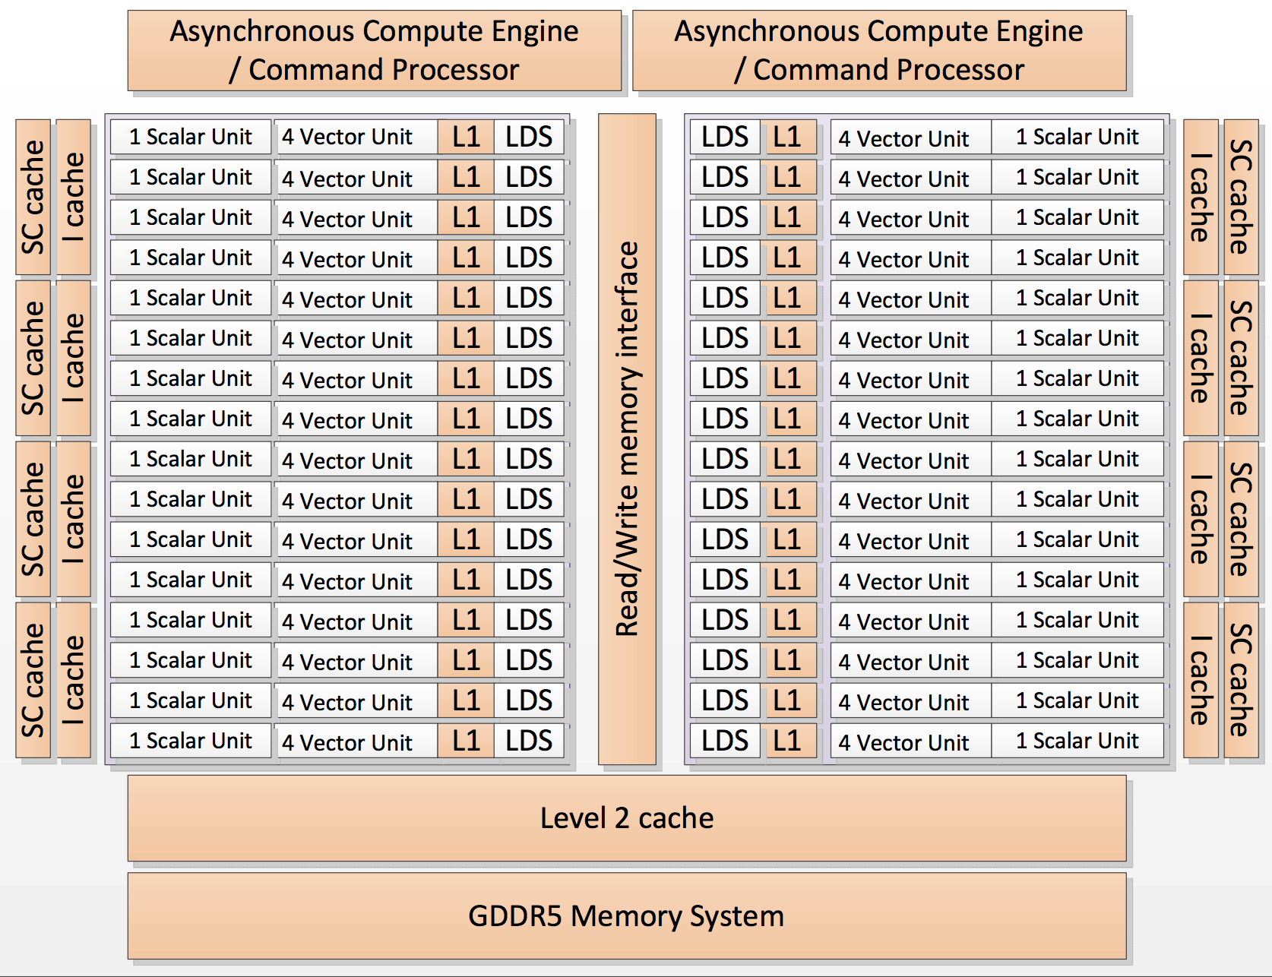
Notes:
there are two command processors, which can process two command queues concurrently. The Scalar Unit, Vector Unit, Level 1 data cache (L1), and Local Data Share (LDS) are the components of one compute unit, of which there are 32. The scalar (SC) cache is the scalar unit data cache, and the Level 2 cache consists of instructions and data.
On devices in the Southern Island family, the four stream cores execute code from four different wavefronts.

Slide 26
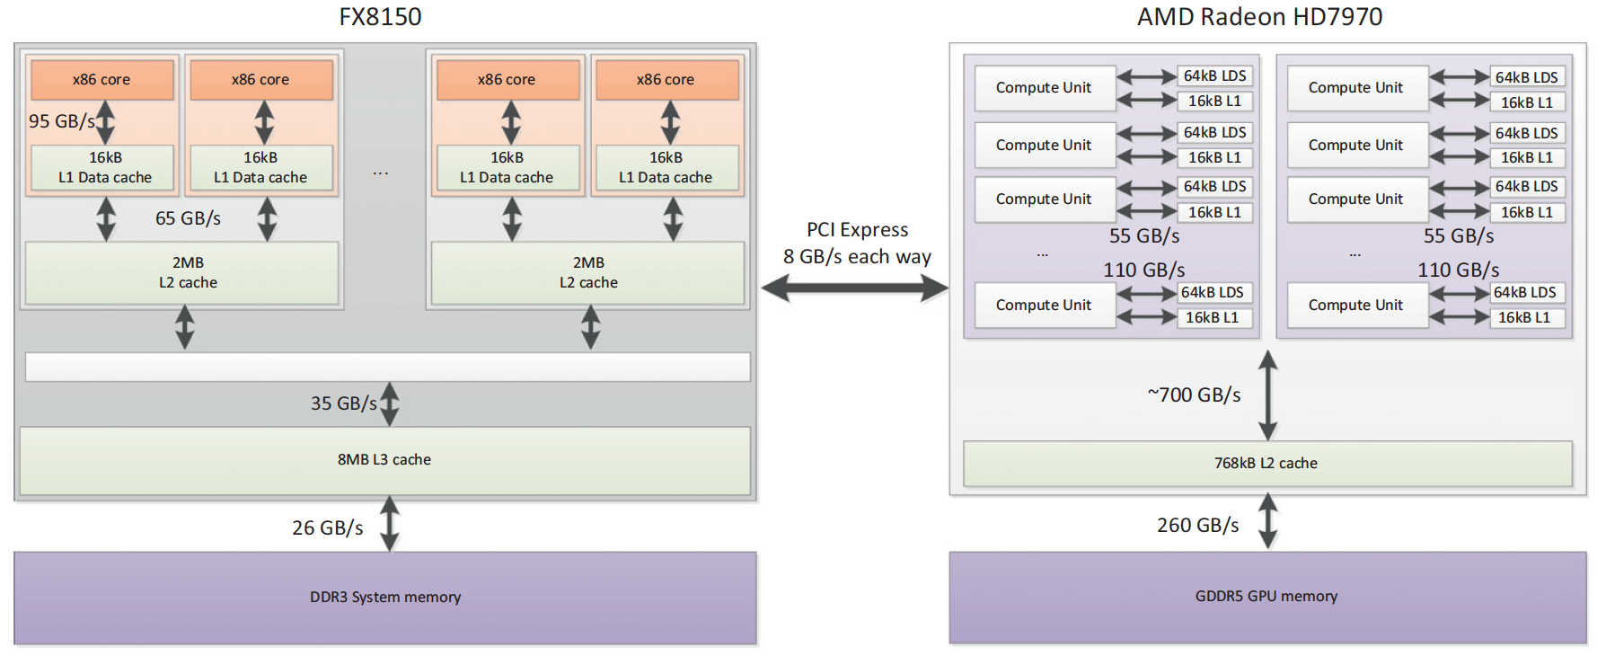
GPU Memory Bandwidth
Show relative speed of GPU memory compared PCIe, etc
PCIe 3.0 - 16GB/s
LDS 100 GB/s for each compute unit
Global 264 GB/s
Pg 78

Slide 27
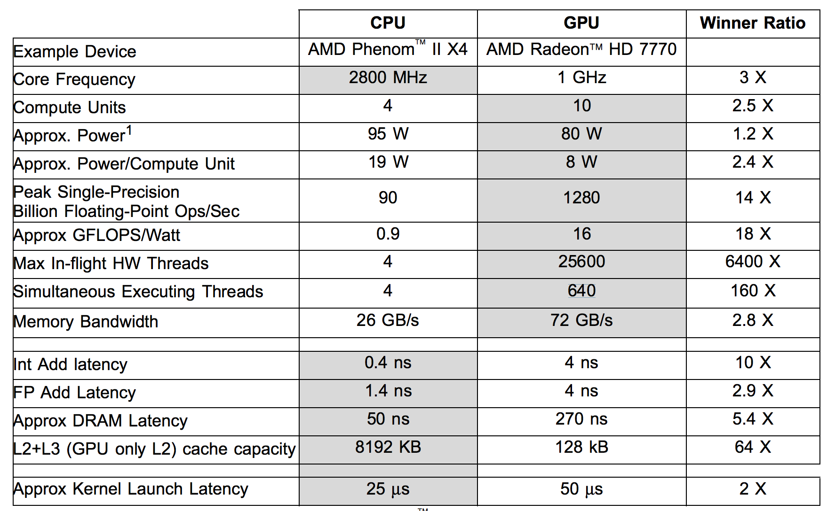
Notes:
The AMD Radeon HD 7770 GPU, for example, supports more than 25,000 in-flight work-items and can switch to a new wavefront (containing up to 64 work-items) in a single cycle. The CPU supports only four hardware threads, and thread-switching requires saving and restoring the CPU registers from memory. The GPU requires many active threads to both keep the execution resources busy, as well as provide enough threads to hide the long latency of cache misses.
In this example, the CPU device contains 512 kB L2 cache/core plus a 6 MB L3 cache

Slide 28
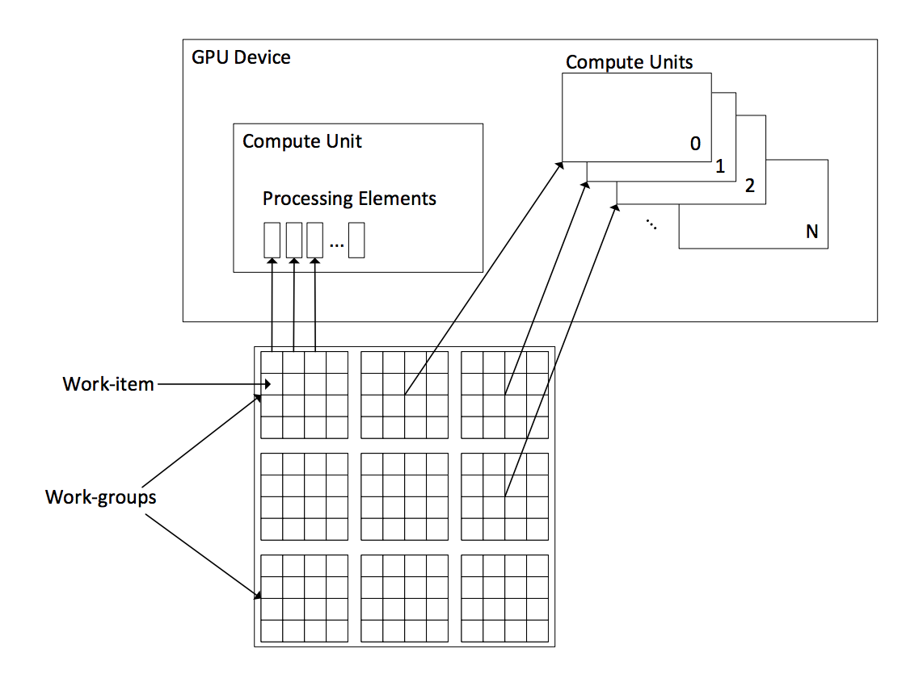
Mapping OpenCL To the GPU
A workgroup executes on the a single SIMD
Each PE is assigned a work-item from the same work group
Branches in a workitem causes the entire wavefront to execute all possible paths serially
Notes:
When flow control operations such as branches are encountered in a work-item, it causes the entire wavefront to execute all possible paths serially. This can have a negative impact on performance since a single work-item taking a divergent path will force the entire wavefront to also execute the path.

Slide 29
Agenda
Introduction & Motivation
Introduction to OpenCL
Introduction to Massively Parallel Architectures / General Purpose GPU
OpenCL By Example
Closing Remarks

Slide 30
OpenCL API – Setup Steps
Notes:
http://syntaxhighlight.in/

Slide 31
Simple Matrix Multiplication Kernel

Slide 32
Building and Creating the Command Queue

Slide 33
Creating the Command Queue and Memory Buffers

Slide 34
Performing the Multiplication

Slide 35
Reading the Result Back

Slide 36
Agenda
Introduction & Motivation
Introduction to OpenCL
Introduction to Massively Parallel Architectures / General Purpose GPU
OpenCL By Example
Closing Remarks

Slide 37
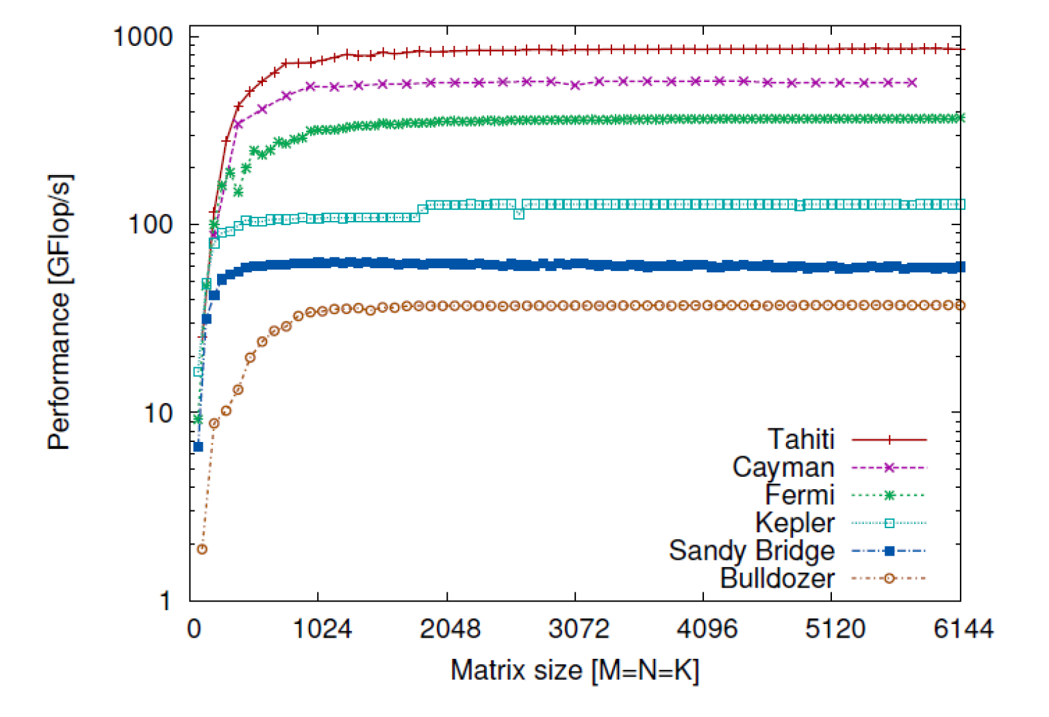
Real World GPU Performance Compared
AMD Radeon HD 7970 (Tahiti) GPU
AMD Radeon HD 6970 (Cayman) GPU
NVIDIA GeForce GTX 670 (Kepler) GPU
NVIDIA Tesla M2090 (Fermi) GPU
Intel Core i7 3960X (Sandy Bridge) CPU
AMD FX-8150 (Bulldozer) CPU
Notes:
GigaFlop (or Gflop) is a billion FLOPS
The performance results are shown in Figure 20 with the HD7970 GPU topping the chart at 863 Gflop/s. Comparing against a fasted CPU, the Intel Core i7, at 64 Gflop/s, which comes out as approx. 13.5 slower than the GPU.

Slide 38
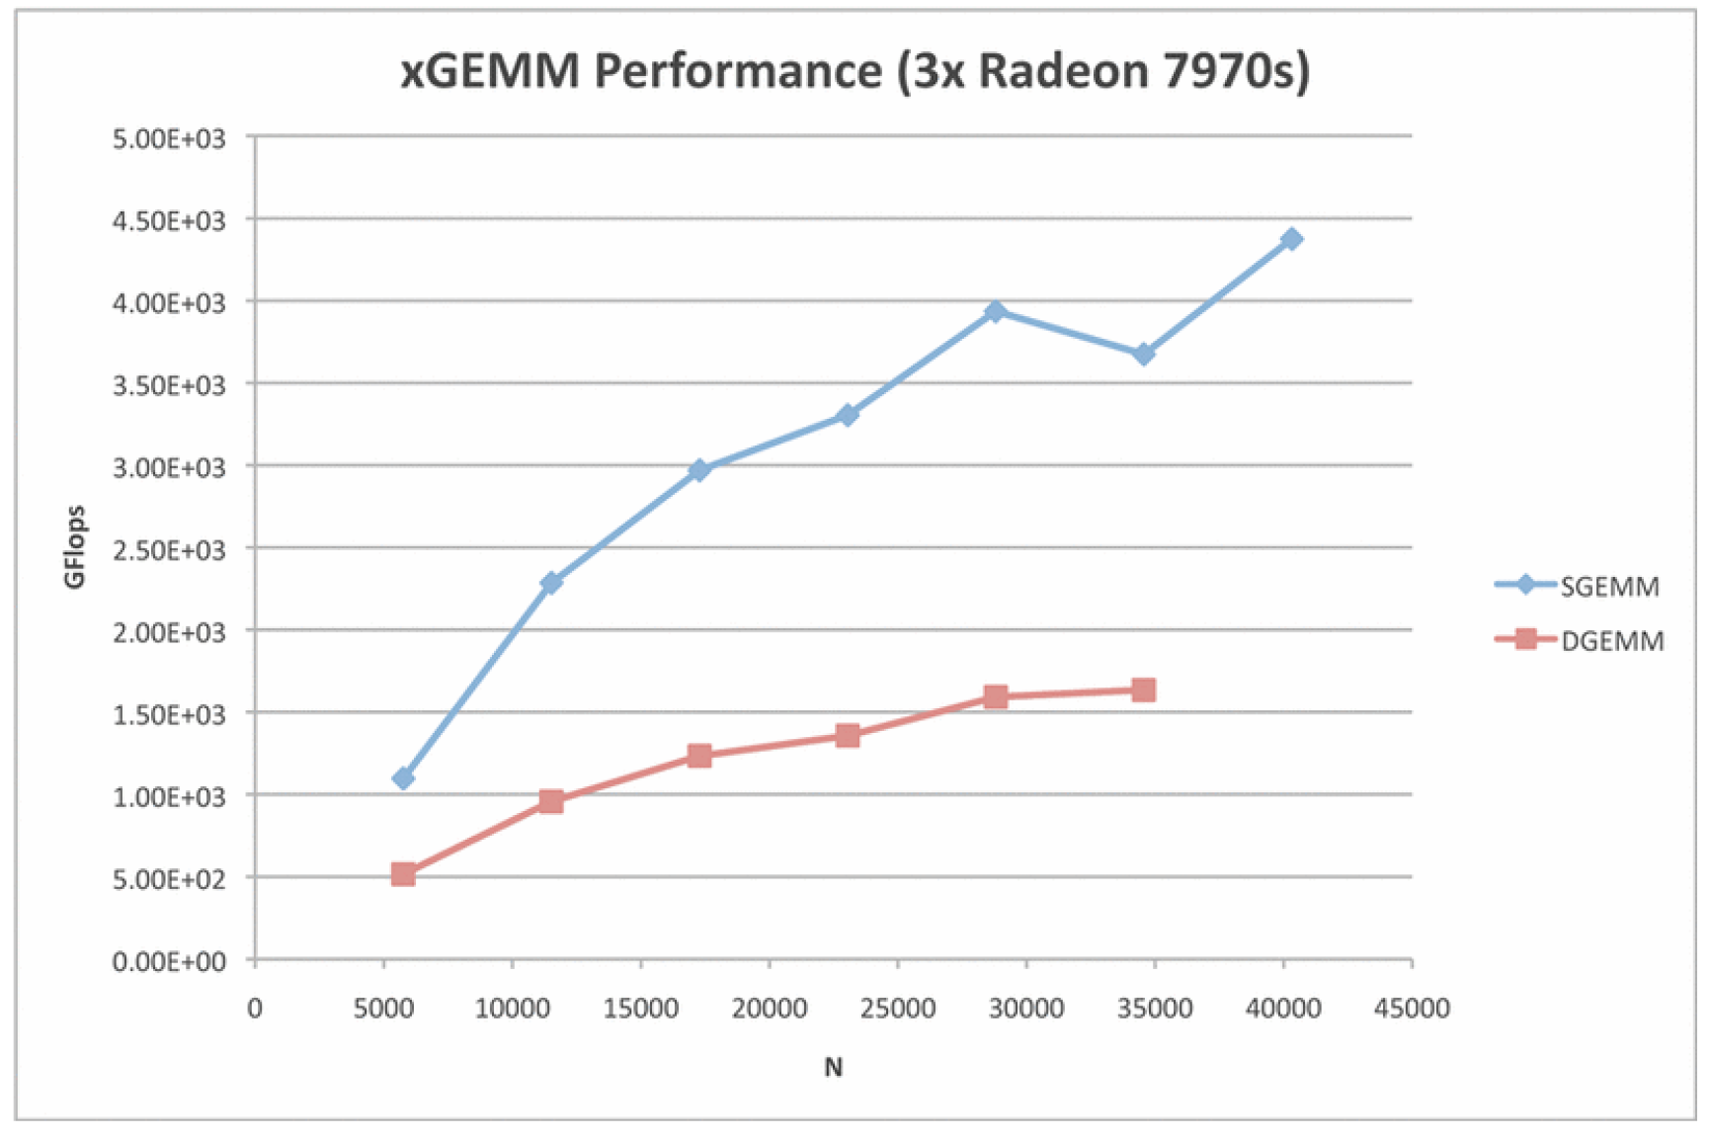
Matrix Multiplication with Multiple GPUs
Notes:
The GPU used is the Radeon HD7970 (codenamed Tahiti).
4.37 TFlops for SGEMM and 1.64 Tflops for DGEMM

Slide 39
Some Results From My Thesis
Rajat05 | H | J (MB) | Pmem (MB) | GPU (s) P=2 | Bock CPU P=6
 |  |  |  |  | Time (s) | Speedup
 | 576 | 3,164.06 | 4,776.47 | 6.13 | 166.99 | 27.22
 | 720 | 4,943.85 | 7,463.23 | 14.22 | 358.76 | 25.23
 | 848 | 6,857.91 | 10,352.70 | 20.42 | 603.05 | 29.54
Add20 | 256 | 6,575.50 | 8,643.50 | 18.37 | 277.90 | 15.13
Circuit_1 | 160 | 6,996.68 | 8,987.50 | 32.29 | 494.83 | 15.33
 | 192 | 10,075.22 | 12,942.00 | 45.63 | 811.37 | 17.78
Hamrle1 | 512 | 196.00 | 284.00 | 0.46 | 9.16 | 19.92
 | 1024 | 784.00 | 1,136.00 | 1.48 | 79.13 | 53.46
 | 2048 | 3,136.00 | 4,544.00 | 5.69 | 667.11 | 117.21
 | 3072 | 7,056.00 | 10,224.00 | 17.17 | 2251.61 | 131.10
rajat11 | 720 | 2,630.13 | 3,571.44 | 6.76 | 201.58 | 29.82
 | 784 | 3,118.49 | 4,234.58 | 8.07 | 267.44 | 33.14
 | 848 | 3,648.41 | 4,954.15 | 9.31 | 338.46 | 36.37
 | 1024 | 5,320.00 | 7,224.00 | 9.30 | 607.83 | 65.34

Slide 40
Questions

Slide 41
References
Somers, Gregory W., “Acceleration of Block-Aware Matrix Factorization on Heterogeneous Platforms.” https://www.ruor.uottawa.ca/handle/10393/35128, 2016
Khronos OpenCL Working Group, “The opencl specification.” https://www.khronos.org/registry/cl/specs/opencl-1.2.pdf, 2012.
Advanced Micro Devices Inc., “Amd accelerated parallel processing opencl programming guide.” http://developer.amd.com/wordpress/media/2013/07/AMD_Accelerated_Parallel_Processing_OpenCL_Programming_Guide-rev-2.7.pdf, 2013.
Advanced Micro Devices Inc., “AMD GRAPHICS CORES NEXT (GCN) ARCHITECTURE.” https://www.amd.com/Documents/GCN_Architecture_whitepaper.pdf, 2012
Matsumoto, K.; Nakasato, N.; Sedukhin, S.G., "Performance Tuning of Matrix Multiplication in OpenCL on Different GPUs and CPUs," High Performance Computing, Networking, Storage and Analysis (SCC), 2012 SC Companion: , vol., no., pp.396,405, 10-16 Nov. 2012
Weber, R.; Peterson, G.D., "A Trip to Tahiti: Approaching a 5 TFlop SGEMM Using 3 AMD GPUs," Application Accelerators in High Performance Computing (SAAHPC), 2012 Symposium on , vol., no., pp.19,25, 10-11 July 2012

